Slide 1
Ch. 305 & Ch. 310 Updates
Rob Wood
Director, Bureau of Land Resources
July 1, 2025

Slide 2
Rulemaking Goals
Reduce review time for shoreline stabilization applications
Better address individual and cumulative impacts from structural shoreline stabilization projects (similar to other states)
Encourage nature-based solutions
Update rules for consistency with statute & DEP best practices

Slide 3
Today’s Agenda
Riprap Shoreline Stabilization through Permit by Rule (PBR)
Structural Shoreline Stabilization in Ch. 310
Biodegradable Stabilization Materials
Additional Ch. 305 (PBR) Updates
Q & A

Slide 4
Riprap Shoreline Stabilization through PBR

Slide 5
Inland Riprap: PBR (Sec. 8)
Applies to great ponds, open-water freshwater wetlands, streams & brooks (not rivers draining more than 25 sq. mi.)
Can the project be kept to <100 linear feet along the shoreline (incl. existing riprap), <200 sq. ft. below NHWL (incl. existing riprap), and <2 feet above NHWL (or up to BFE on a stream or brook, if higher)? If yes:
Is the project not in a Significant Wildlife Habitat? If yes:
The project qualifies for PBR and must adhere to the applicable standards

Slide 6
Coastal Riprap: PBR (Sec. 8)
Is the project designed to protect a water-dependent structure, a subsurface wastewater disposal system within 25 feet of the eroding shoreline, a publicly owned open space, or a dwelling, building, or road located within 100 feet of the eroding shoreline and built before 2026? If yes:
Is the bluff considered unstable or highly unstable by MGS (mapped or site-specific determination), and if not, can the applicant demonstrate landward erosion of at least 1 foot per year over multiple years or 5 feet in one year? (This does not apply to water-dependent structure or subsurface wastewater disposal system). If yes:

Slide 7
Coastal Riprap: PBR (Sec. 8)
Can the project be kept to <125 linear feet along the shoreline (incl. existing riprap/seawalls), <400 sq. ft. below HAT (incl. existing riprap/seawalls), and <1 foot above BFE? If yes:
Is the project not located in Significant Wildlife Habitat except Tidal Waterfowl and Wading Bird Habitat that is not saltmarsh or mudflat; in a saltmarsh; in a coastal sand dune system (or within 25 feet); or in a coastal barrier resources system unit? If yes:
The project qualifies for PBR and must adhere to the applicable standards

Slide 8
PBR Standards (Sec. 8)
Previous Sec. 8 standards still in place. New standards added:
No removal of trees >4 in. DBH for placement of riprap (may remove trees for regrading to meet <1.5:1 slope requirement, equipment access, hazard tree removal)
Must plant 10-foot-wide native vegetation buffer, unless not feasible due to structure near shoreline or presence of existing buffer >5 feet
Riprap cannot be placed within 5 ft. of an abutting property, unless there is riprap on the abutting property (up to the property line) or abutting property owner gives permission

Slide 9
PBR Standards (Sec. 8)
A yard cannot be extended closer to the water, or elevated
If feasible, vegetation must be planted within riprap (encouraged, not required)
For coastal projects, excavated sediment must be placed in riprap crevices, unless determined not to be feasible by DEP
Coastal projects must be approved by a design professional—engineer, contractor, or consultant—unless waived by DEP (no waiver in V-Zone)

Slide 10
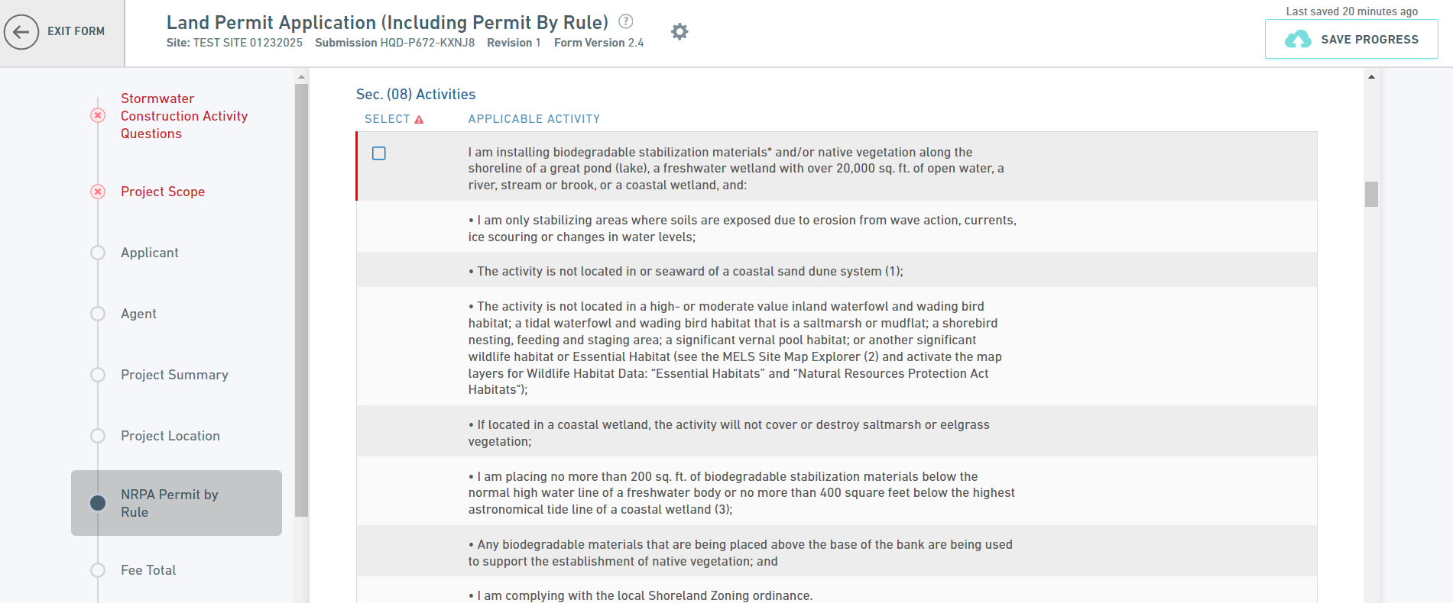
MELS Form

Slide 11
Structural Shoreline Stabilization in Ch. 310

Slide 12
Ch. 310 Shoreline Stabilization
Projects limited to designated purposes: Is the project designed for protection of a water-dependent structure, a subsurface waste disposal system (within 25 feet or necessary to prevent effluent outbreak), an open space that serves the public (doesn’t have to be publicly owned), farmland, or a structure essential to the current use of the property located within 100 feet of the eroding shoreline that cannot be practicably relocated and was built before 2026? Or is it necessary to protect a structure built before 2026 that is at significant risk of a landslide? Or is a health and safety project, as defined in Ch. 310?

Slide 13
Ch. 310 Shoreline Stabilization
If yes (if the project is designed for an eligible project purpose), structural stabilization may be permitted, if the length, height and wetland fill are minimized:
  Length limited to structure/space that needs protection
  Height limits same as Ch. 305 (PBR), with flexibility to go higher if necessary
  Wetland fill must be avoided, minimized and (if applicable) compensated for
If no (if the project is not designed for an eligible project purpose), toe protection using riprap may be permitted up to 3 feet high, if MGS determines the bluff is not a significant source of sediment to a coastal wetland

Slide 14
“Cannot be practicably relocated”
Applicant must submit analysis of cost, technology and logistics of relocating the structure to a location farther than 100 feet from the eroding shoreline
It is not expected that most dwellings, buildings, roads, and other large structures can be practicably relocated, but the applicant still must address this alternative

Slide 15
Ch. 310 Alternatives Analysis
Rebuttable presumption that vegetation and/or biodegradable stabilization materials can practicably stabilize a shoreline in a low-energy environment with little or no wave action and stable coastal bluffs
  Exceptions for health or safety projects, water-dependent structures, and septic systems
Open coastline is not considered a low-energy environment
If a bluff is mapped as stable but appears unstable, contact Maine Geological Survey (MGS)
Rebutting the presumption requires analysis of cost, technology, and logistics to show biodegradable materials and/or vegetation is not practicable

Slide 16
Ch. 310 continued
10-foot-wide native vegetation buffer required, unless not practicable
A yard cannot be extended closer to the water
For coastal projects, excavated sediment must be placed in riprap/structure, unless not feasible
Application submission requirements mirror PBR submission requirements

Slide 17
Biodegradable Stabilization Materials

Slide 18
Biodegradable Stabilization Materials
“Natural, plant-based biodegradable or compostable fabrics, erosion control blankets, and logs or rolls made from coir, jute, straw, or other similar materials, including materials that contain or use gravel or cobble; discarded holiday trees and native trees, native brush, or native biodegradable materials; tree root wads; and wooden stakes. Metal anchors or cables may be used to secure those materials. Anchors may also include cobbles or small boulders that are not obtained from the shoreline or below the normal high water line or within the coastal wetland.”

Slide 19
Biodegradable Stabilization Materials
Most shoreline stabilization projects using only biodegradable stabilization materials and vegetation are eligible for permit-by-rule (PBR), unless the project:
  Places more than 200 sq. ft. of biodegradable materials (not including live vegetation) in a freshwater resource or more than 400 sq. ft. of biodegradable materials (not including live vegetation) in a coastal wetland
  Covers or destroys saltmarsh
  Is in a Significant Wildlife Habitat, except Tidal Waterfowl and Wading Bird Habitat that is not saltmarsh or mudflat
  Uses stainless steel anchors/cables
No limits on purpose of project, length, or height

Slide 20
Biodegradable Stabilization Materials
Biodegradable stabilization materials may be used for coastal sand dune restoration through PBR under Ch. 305 Sec. 16-A (metal anchors not allowed)
Up to 200 sq. ft. of biodegradable stabilization materials may be used to support saltmarsh restoration through PBR under Ch. 305 Sec. 12

Slide 21
Additional Ch. 305 (PBR) Updates

Slide 22
Ch. 305: Section 8-A (new)
Allows increasing height of existing vertical seawall or retaining wall in/adjacent to a coastal wetland by up to 1 foot above BFE (not in a coastal sand dune system)
Please review applicability and standards

Slide 23
Ch. 305: Sec. 4 Updates
Allows increasing height of pier/wharf/dock in coastal wetland up to 4 feet above BFE when replacing
Allows increasing height of vertical seawall, retaining wall, or riprap in/adjacent to coastal wetland up to 1 foot above BFE when replacing
Allow increasing height of principal or accessory structure in (or partly in) a resource by up to 3 feet above BFE when replacing

Slide 24
Ch. 305: Sec. 16-A Updates
Allows beach scraping for dune restoration
Allows municipal seaweed removal from beach

Slide 25
Ch. 305: All Sections
Uses Highest Astronomical Tide
Updated erosion control standards
Notice must be given to abutters and municipality (not everyone within 1,000 feet)
Review timeline is 20 working days (38 M.R.S. § 344-B)

Slide 26
Q & A

